Slide 1


Linux Essentials
And
Red Hat System Administration
enablers of your digital enterprise goals

Slide 2

You are learning from…
Raju Vadarevu
2.2 years in Intelizign
Siemens Project - Mindsphere
Previous Trainings:
Terraform – Code your Infrastructure
Async in JavaScript – Let’s sync in async
OAuth Fundamentals – Security to Next Level

Slide 3


A Refresher
What is an Operating System ?
Operating
System
User
Collection of Software Components
Hardware
What is a Kernel ?
Operating
System
Device Drivers
Kernel
Hardware

Slide 4





Linux – The Beginning!
UNIX
Companies and Academic Institutions
Various clones of UNIX
Linux Kernel Development
GNU Project

Slide 5
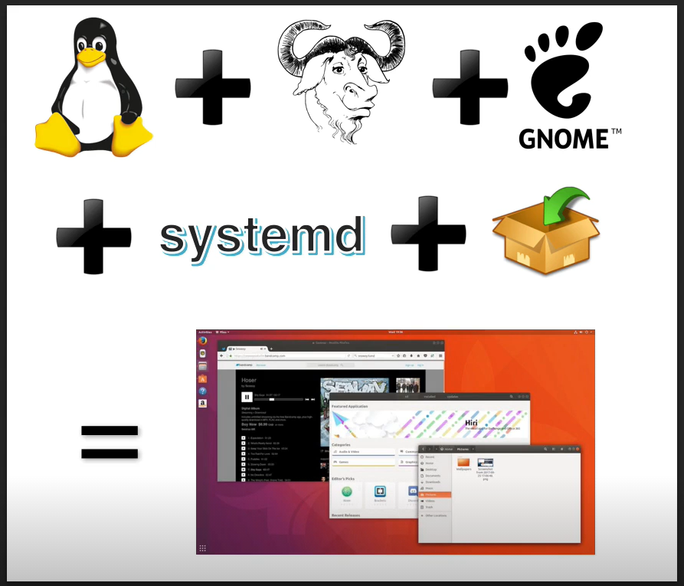

Linux Distribution Components

Slide 6
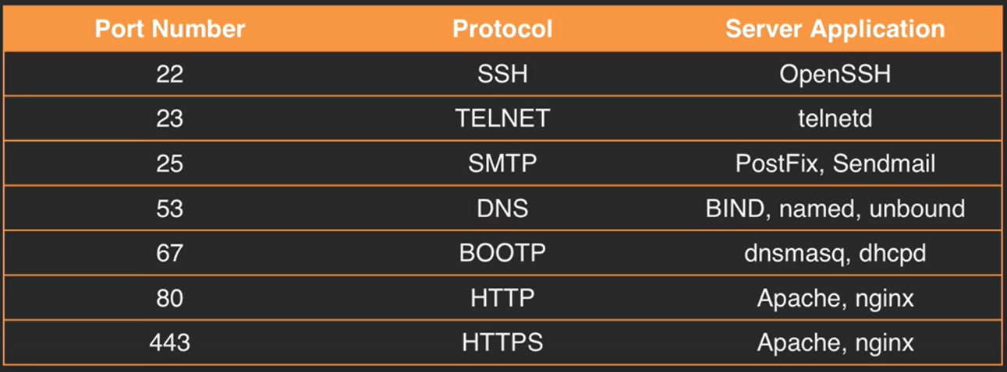
Linux as a Server

Slide 7

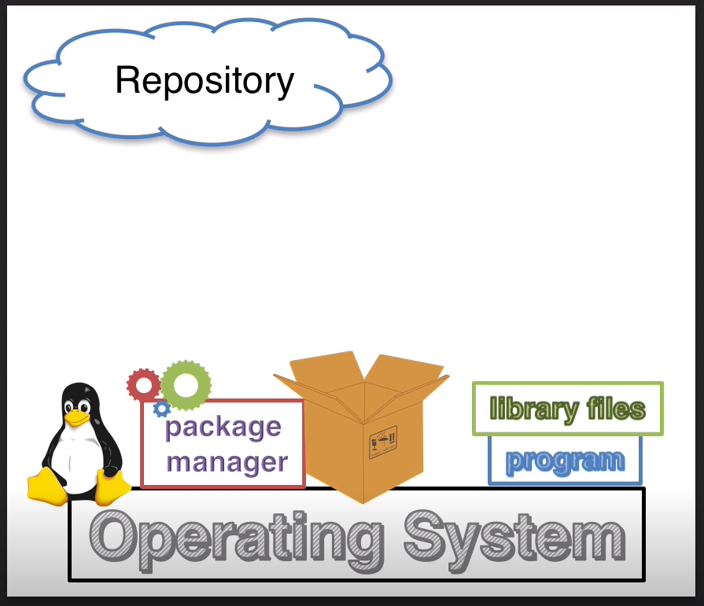
Package Management

Slide 8


Package Management
Installing from Source
Pre-built Packages
.rpm
.deb
RHEL
Fedora
CentOS
Suse
OpenSuse
Yum
Zypper
GNOME
/etc/
Debian
Ubuntu
Linux Mint
Elementary OS
apt
GNOME
/etc/apt/

Slide 9
Basic Commands
ls
top
touch
tar
head
chmod
env
uname
man
gzip
tail
chown
whoami
cd
info
gunzip
cut
chgrp
su -
pwd
mkdir
bzip2
sort
reboot
history
cp
bunzip2
wc
halt
echo
mv
zip
grep
poweroff
bash
rmdir
unzip
nano
shutdown
export
rm
less
vim

Slide 10
Login Shell – Behind the Scenes!
/etc/profile
~/.bash_profile
~/.bashrc
/etc/bashrc
~/.bash_login
~/.profile
LOGIN SHELL

Slide 11
Miscellaneous Topics
Shell Variables
Output Redirection
Regular Expressions
Shell Scripting
Quoting
Searching
Command Line Help
Archiving and Compression

Slide 12
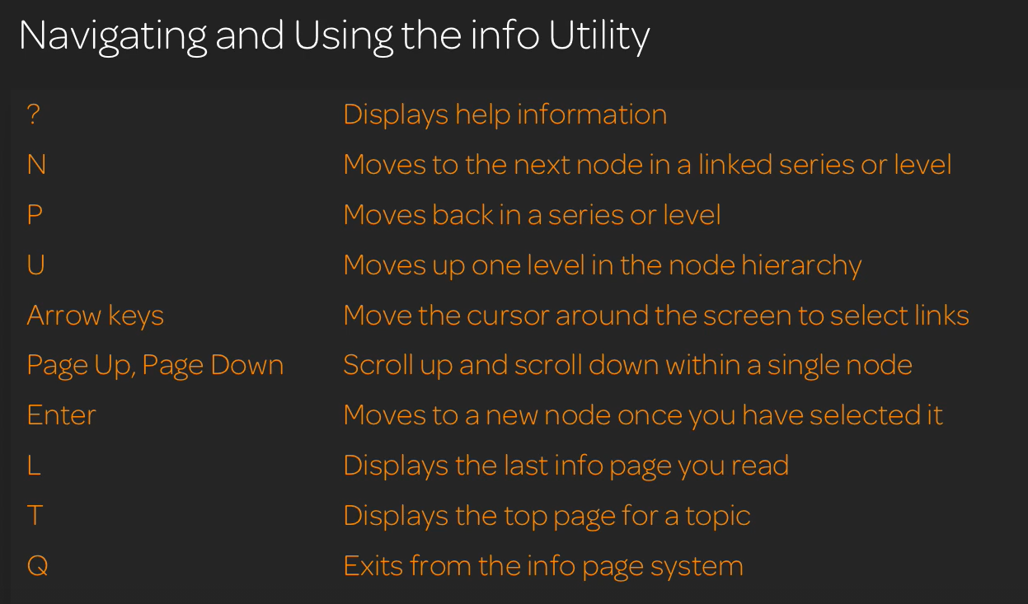
Info utility

Slide 13
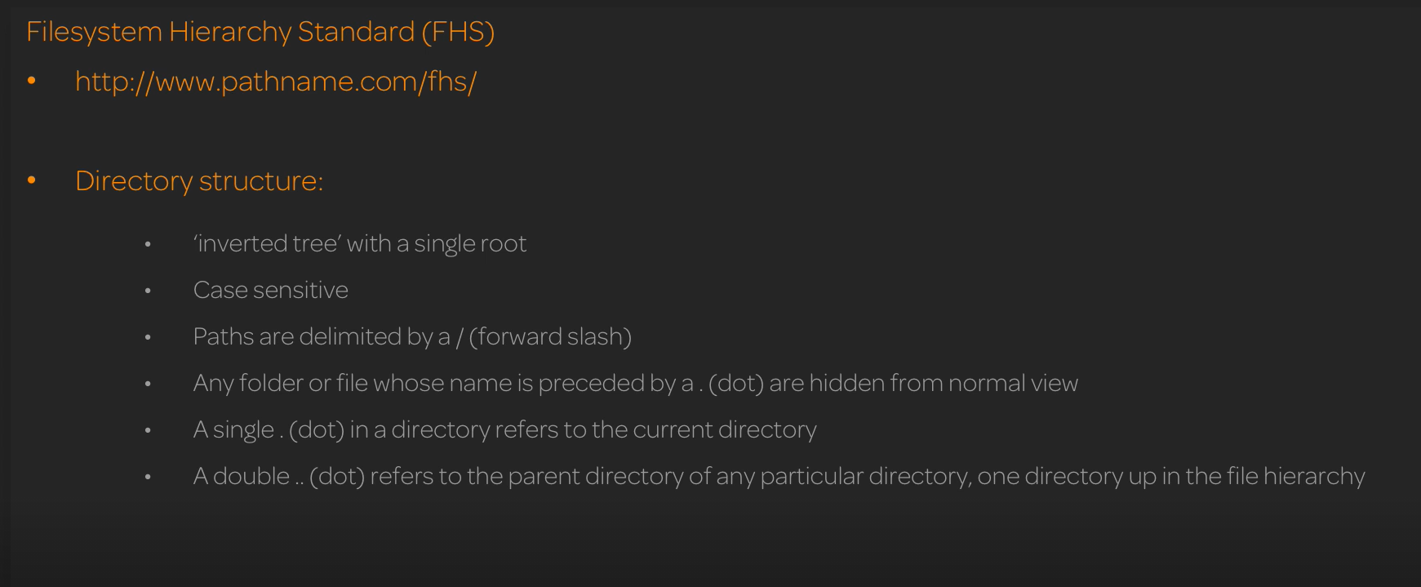
The Linux File System
Absolute and Relative Paths

Slide 14
Hardware and Process Information
/proc/cpuinfo
ps
free
/proc
dmidecode
top
/dev/
/var/log
lsblk
dmesg
df

Slide 15
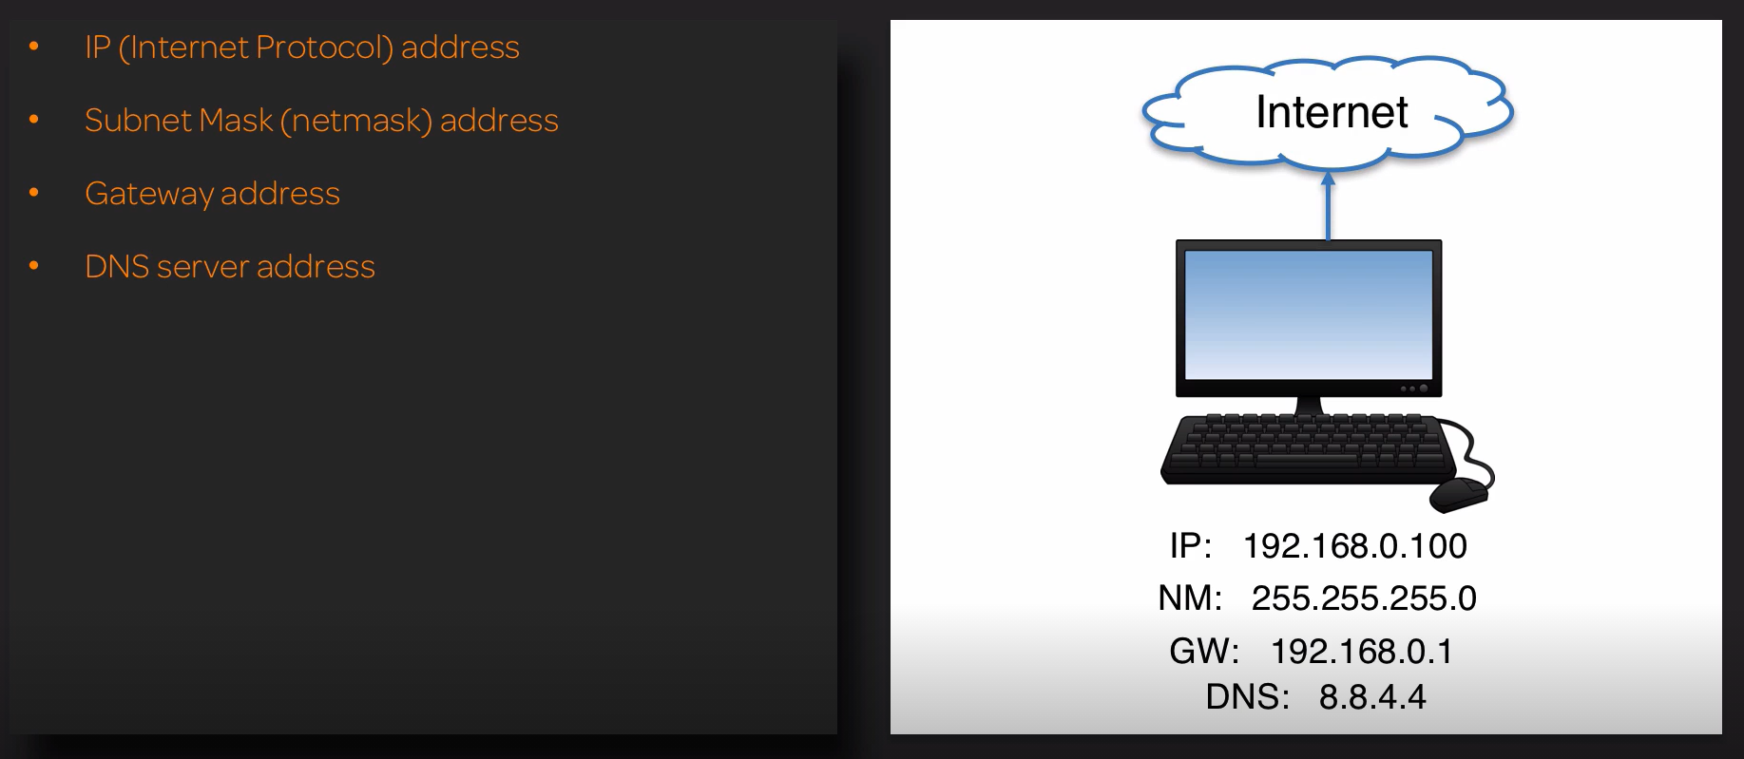
Networking

Slide 16
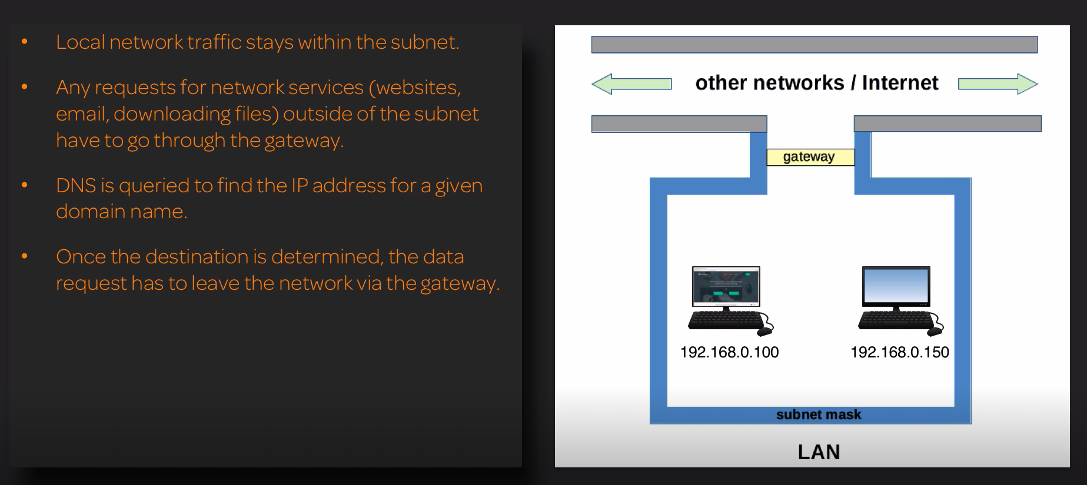
Networking

Slide 17
Networking
ip addr show
host
ifconfig
/etc/hosts
ip route show
route
netstat -r
/etc/resolv.conf

Slide 18
Users and Groups
who
groupadd
last
w
useradd
id
/etc/default/useradd
/etc/sudoers
/etc/skel
/etc/passwd
passwd
/etc/group
/etc/shadow

Slide 19
File and Directory Permissions
rwx
rwx
rwx
U
G
O
r=read
100
4
w=write
010
2
x=execute
001
1
chmod
chown
chgrp

Slide 20
Links
ln
Quick access
Symbolic Link
Hard Link
link
file
link
file
inode

Slide 21
Thank you for taking time and attending this Training
enablers of your digital enterprise goals

